Slide 1
National Students Survey
University of Liverpool?
Liverpool Medical School?

Slide 2
November 2011
Annual Review of MB ChB Programme
National Students Survey

Slide 4
Key Recommendations
Curriculum
Ongoing Review
Fit for modern NHS
Patient Based

Slide 5
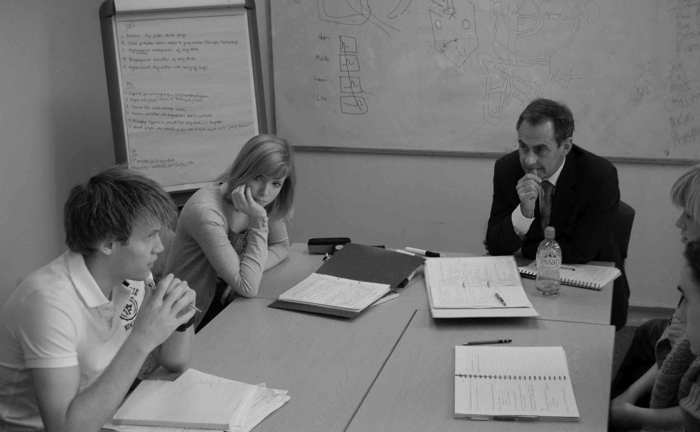
Key Recommendations
2. Problem-Based Learning (PBL).
Maintained and developed
Scenarios reviewed
Modernised

Slide 6
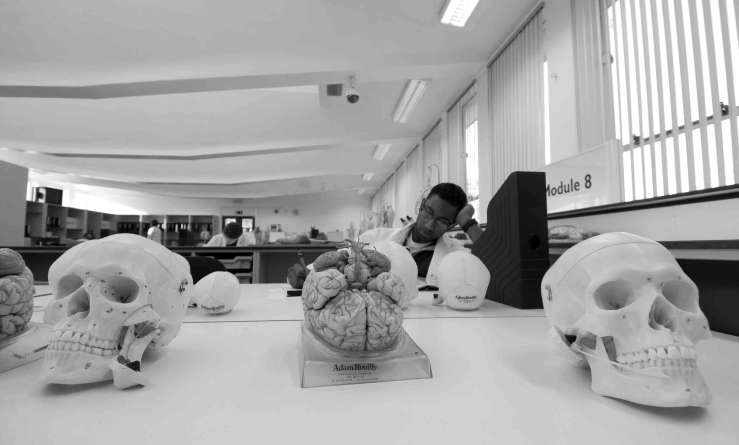
Key Recommendations
Human Anatomy Resource Centre (HARC)
-Enhanced to support PBL
-Demonstrations
-Anatomy Demonstrators

Slide 7
Undergraduate/Postgraduate Interface
John Earis
University Hospital Aintree

Slide 8
Who is responsible for training medical students?
UNIVERSITY OF COURSE

Slide 9
University Responsibilities
Selection
Decides the Curriculum (GMC)
Decides teaching systems (PBL)
Organises hospital/community placements
Assessment and award degrees
Pastoral Care

Slide 10
Who is responsible for Training Medical Students ?
University AND NHS Trusts
(Hospital and Community)
What proportion of SIFT and the University Medical Student Funding directly benefits the students??

Slide 11
Approx % of time spent in Clinical Placements (Hospital in brackets)
Year 1 0%
Year 2 60% (40%)
Year 3 40-60%
Year 4 95% (80%)
Year 5 95% (95%)

Slide 12
Foundation Doctors Views
Newly qualified doctors' views about whether their medical school had trained them well: questionnaire surveys
Judith Cave, Michael Goldacre, TrevorLambert, Kath Woolf, Alison Jones and JaneDacre
BMC Medical Education 2007, 7:38

Slide 13
% of Students who felt prepared for F1 Year (Cave et al 2007)

Slide 14
% of Students Prepared for F1 Year
(Cave et al 2007)
Liverpool

Slide 15
National student Survey: Guardian Rankings 2012

Slide 16
Liverpool Graduates
Mersey Deanery

Slide 17
GMC Survey 2010
Mersey Deanery
Same Hospitals
Same Support Processes
Same Trainers and Educational Supervisors

Slide 18
Key Indicators from the 2010 GMC Trainee Survey from Mersey Deanery Trainees Compared Across Deaneries
Overall Satisfaction
Clinical Supervision
Handover
Hours of Education
Educational Supervision
Procedural Skills Score
Undermining Scores
Data from: GMC Annual Trainee Survey 2010. http://reports.pmetb.org.uk/

Slide 19
Overall Satisfaction

Slide 20
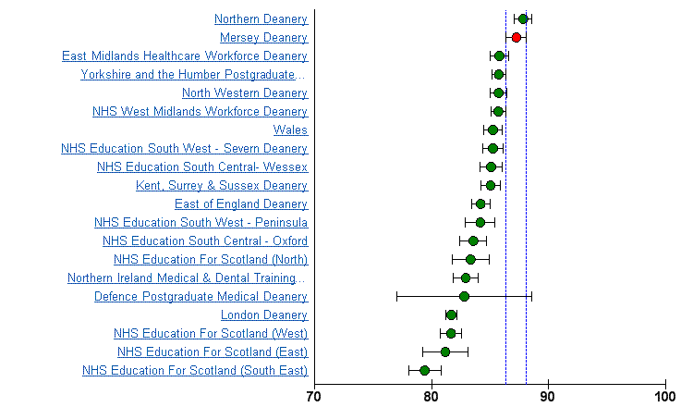
Educational Supervision

Slide 21
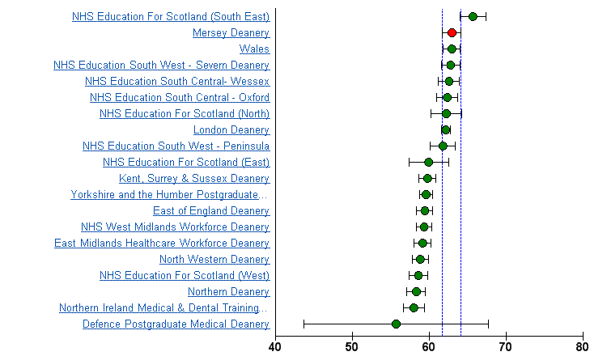
Handover

Slide 22
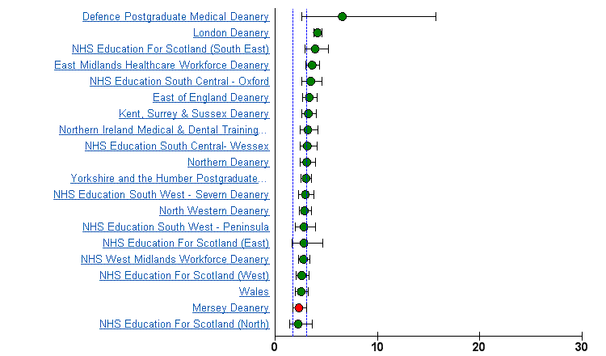
Consultant Undermining Scores

Slide 23
Conclusions
Students are not satisfied with aspects of their course
When they become F1s they feel they are well prepared (shadowing PSP)
NHS is responsible for much of Medical Students training
Liverpool students well prepared but we could do better

Slide 24
National Students Survey
University of Liverpool?
Liverpool Medical School?

Slide 25
DREEM Questionnaire Data
Sam Cocksedge
F1 Doctor WUTH

Slide 26
The DREEM Questionnaire
The research questionnaire design utilizes a combination of qualitative and quantative techniques allowing for the methodology to be used to develop a non-culturally specific instrument that can be standardised and validated, enabling the DREEM study to be used globally. Roff S. (The Dundee Ready Education Environment Measure (DREEM) – a generic instrument for measuring students’ perceptions of undergraduate health professions curricula. Med Teach. 2005:27; 322-325)

Slide 27
The DREEM gives a global score out of 200 for the 50 items it contains. It has five sub-scales relating to;
Students’ Perceptions of Learning
Students’ Perceptions of Teachers
Students’ Academic Self-Perceptions
Students’ Perceptions of Atmosphere
Students’ Social Self-Perceptions

Slide 28
Questionnaires from 101 participants (approx. 1/3 of the year) were utilised and these were collected at random from 5th year medical students through various methods.
The collection of data was randomised by finding students to participate who were in compulsory University sessions

Slide 29
Students were asked to read the DREEM questionnaire’s 50 statements and use the Likert-type scale to respond.
Each statement was then scored between 4 and 0 depending on the statement and how strongly the student agreed or disagreed.
(McAleer S, Roff S. A practical guide to using the Dundee Ready Education Environment Measure (DREEM))

Slide 30
Results
The average overall score for the questionnaires was 132.9, within a range of 170-64.
This indicates that there is more positive than negative perceptions regarding the course as a whole.
0-50 Very Poor
51-100 Plenty of Problems
101-150 More Positive than Negative
151-200 Excellent

Slide 31
Average Score Distribution

Slide 32
Where scored high or low?

Slide 33
Students’ Perception of Learning
Overall average score - 31.2/48
High Score (3 or above) –
‘I am encouraged to participate in teaching sessions’
‘The teaching helps to develop my confidence’
Low Score (2 or below) -
‘I am clear about the learning objectives of the course’

Slide 34
Student’s Perception of Course Organisers
Overall Average Score - 28.2/44
High Score –
‘The course organisers espouse a patient centred approach to consulting’ (average score 3.1)
‘The course organisers get angry in teaching sessions’ (average score 3 – this statement was negatively marked, thus a high score in this area is deemed a positive remark).
Low Score-
‘the course organisers are good at providing feedback to students’ (1.7 average score)

Slide 35
Student’s Academic Self Perception
Overall Average Score - 22.6/32
High Score –
‘I am confident about passing the year’ (3.4)
‘Last year’s work has been good preparation for this years work’ (3)
‘I have learned a lot about empathy in my profession’ (3.2)
Much of what I have to learn seems relevant to a career in healthcare (3.1)
Low Score –
‘I am able to memorize all I need’ (1.7)

Slide 36
Student’s Perception of Atmosphere
Overall Average Score - 31.5/48
High Score –
‘There are opportunities for me to develop interpersonal skills’ (3)
Low Score –
None (below 2)

Slide 37
Student’s Social Self Perceptions
Overall Average Score - 19.7/28
High Score –
I have good friends on this course’ (3.4)
‘My social life is good’ (3.2)
‘My accommodation is pleasant’ (3.2)
Low Score –
‘There is a good support system for students who get stressed’. (2)

Slide 38
Comparisons
22 question survey from the NSS
A generic questionnaire used across all subjects and universities - there is some overlap between the two questionnaires.
Overall I am satisfied with the quality of the course
The teaching on my course
Assessment and feedback
Academic support
Organisation and feedback
Learning resources
Personal development

Slide 39
Conclusions
DREEM questionnaire has a more diverse question base; its 50 questions can cover a broader scope.
A precise opportunity for reform utilising a tool that is designed specifically for medical education
An accurate intervention overall by that school of medical education
The precision for reform to alter student’s scientific task orientation and caring attitudes

Slide 40
Students’ Perspective
Luke Hedges-Winslow
5th Year Medical Student
Academic Student Representative 2011/12

Slide 41
Things scoring badly in DREEM
‘I am clear about the learning objectives of the course’
‘the course organisers are good at providing feedback to students’
‘I am able to memorize all I need’
‘There is a good support system for students who get stressed’.

Slide 42
‘I am clear about the learning objectives of the course’
PBL course – curriculum is within scenarios
Students felt a lack of a clear curriculum
This was raised with the faculty
Over year developed a “Curriculum MAP”
Online resource highlighting all elements of the course and how aspects of the curriculum fit together

Slide 43
‘the course organisers are good at providing feedback to students’
Students have raised issues in the past regarding feedback from exams, special study module (SSM) reports and clinical attachment
Over past few years exam feedback has improved
Individual feedback from practical (OSCE) exam
Marking sessions of formative exam papers
Individual feedback given from exam papers of strongest and weakest areas
SSM – now only 4 instead of 6 over the 5 years – means convenors can be better selected to stick to deadlines on marking
Clinical attachment – Educational supervisors who …………monitor progress

Slide 44
‘I am able to memorize all I need’
Clearly medicine is an extremely vast topic area and it will be difficult to memorize everything
Course is structured so as to help students remember key topics by revisiting areas over the 5 year course

Slide 45
‘There is a good support system for students who get stressed’.
This has been an issue over the past years.
The personal tutor scheme – issues raised regarding actual contact with some tutors
Faculty continue to work to improve the system –
Educational supervisors to monitor progress
Contact numbers/emails if you need to talk
Liverpool Medical Students Society (LMSS) buddy system in place for first years
LMSS Welfare representative

Slide 46
NSS student discussion
Met with 15 students across the 5 year groups
Discussed elements of the NSS 2010/11 which scored badly by students
Some of the main points were similar to the DREEM findings
Presented minutes to faculty

Slide 47
Results from discussion
Felt more guidance was needed regarding various aspects of course
The faculty have now set up supporting lectures for the elements needing more guidance
Feedback issues raised
Faculty have made alterations which students felt as steps in the right direction
Basic science teaching poorly rated
Faculty have organised more lectures and accommodated teaching sessions within the anatomy resource centre.

Slide 48
Does the faculty involve us?
Academic representative
Invited as members of various faculty bodies:
Board of studies
Admissions sub group
Academic quality and standards committee
Combined student parliament
academic representative, year representatives from all years and faculty members involved with course
Discuss problems across year groups in aim to find solutions and improve the course to suit the students needs

Slide 49
Closing notes…
I have been within the medical school for 5 years and I can speak from experience that changes over the years have been positive
There is a great relationship between the faculty and the students
The faculty does listen to the students and continually works to improve the course to suit our needs

Slide 50
Zirva Ahmad – Year 5 student
“Our medical school is one of the few that exposes us to the clinical world early, and allows us to have more exposure than nearly all medical schools around the country, putting us in better stead when we graduate and start working. Year by year improvements are being implemented, and faculty have listened to our feedback to tackle the problems we face. To list a few examples of these changes that will benefit us, they include electives being after finals (meaning we are able to apply our knowledge better!), fewer SSM's, actual anatomy teaching and more teaching in hospitals.”

Slide 51
Thank you
Any questions?

